Slide 1
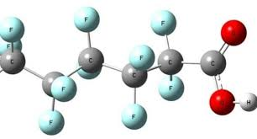
PFAS What you need to know about “forever chemicals”
Marguerite Adelman
WILPF US
Earth Democracy Committee
pfasinfo@wilpfus.org

Slide 2
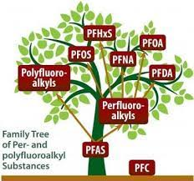
What are PFAS?
Per- and polyfluoroalkyl substances, also known as PFAS or “forever chemicals,” are a group of over 12,000+ man-made, toxic chemicals used in a variety of products.
PFAS are bio-accumulative and travel through air, water, soil, dust, and food.
Two types of PFAS -- PFOA and PFOS -- have been phased out of production in the US, but not out of our environment. However, these two types have been replaced by other forms of PFAS that also cause severe threats to our health and environment.

Slide 3
Why should we be concerned about PFAS?
These chemicals may cause…
various forms of cancer
thyroid disease
ulcerative colitis
high cholesterol
pregnancy-induced hypertension
weakened immune systems
reproductive health problems in both men and women
learning and developmental disabilities in infants and children
Studies have proven that PFAS have been present in the blood of most Americans and the breast milk of 100% of the women tested.

Slide 4
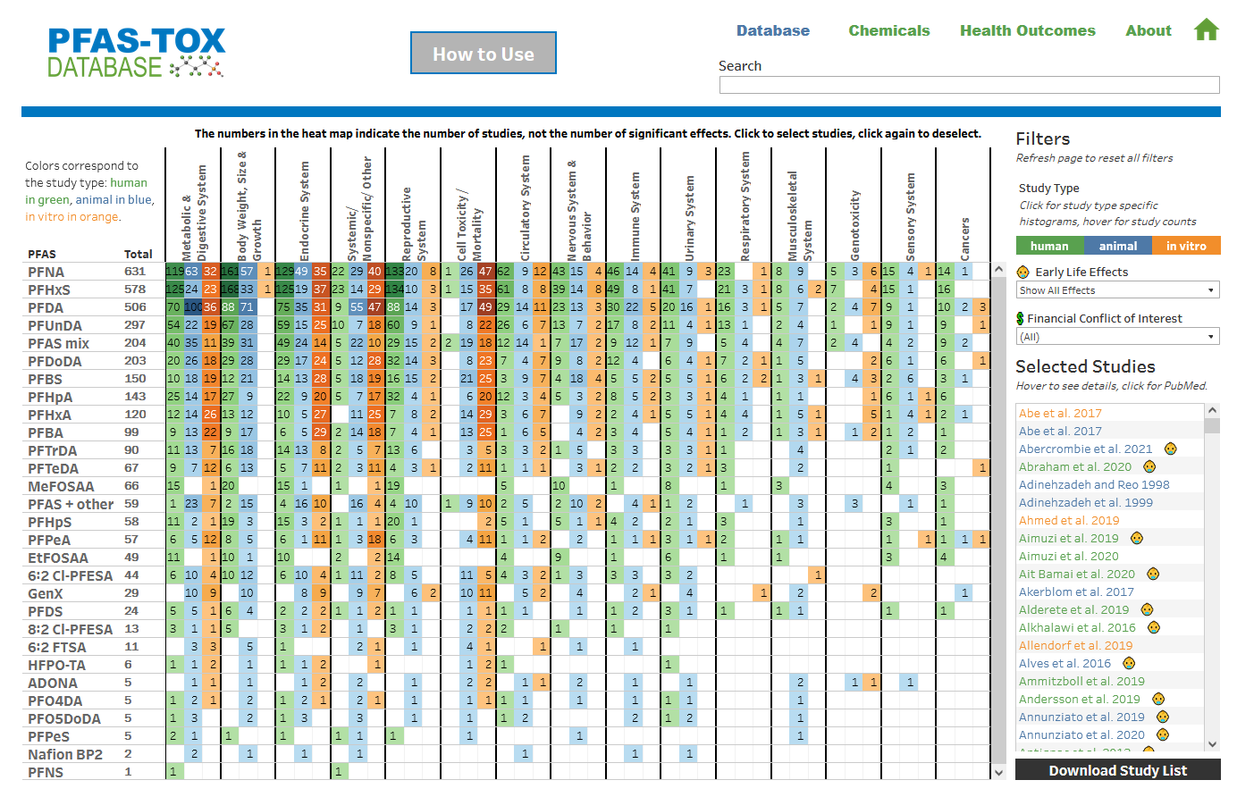
PFAS-TOX Database
https://pfastoxdatabase.org/

Slide 5
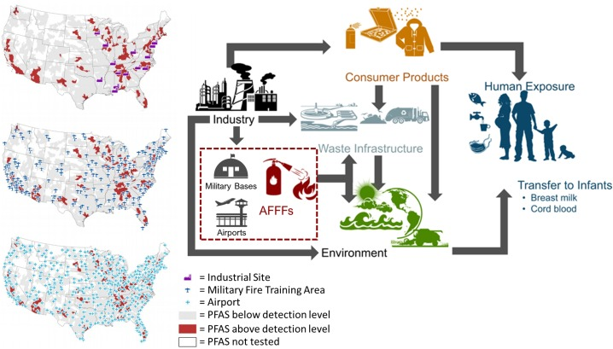
Where do PFAS come from?

Slide 6
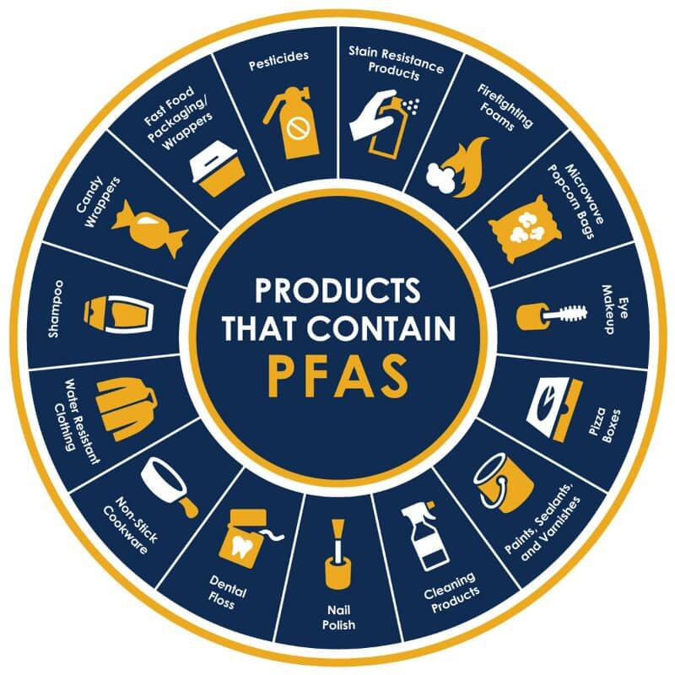
What products contain PFAS?
If you see the words “non-stick,” “water-resistant,” “stain-resistant,” “grease-resistant, or “long lasting,” you should check the product for PFAS.
Sunscreen: 67% contain harmful ingredients to children and adults
Cosmetics: 48% of cosmetics contain PFAS chemicals
Personal Care Products: contact lenses, dental floss, toilet paper, shampoos, conditioners, moisturizers, nail polish, female hygiene products, etc.
Food: Seafood and some produce contain high amounts of PFAS
Cleaning Products: Floor wax
Bug Repellants and Pesticides
Household and Consumer Products: rugs, paints, mattresses, clothing—school uniforms, outdoor clothing—rain and snow, shoes, ski wax, artificial turf, etc.
Cookware and Food Containers: especially fast-food wrappers, microwave popcorn, pizza boxes, etc.
Children’s Products: diapers, clothing, etc.
Water: tap, bottled, and well water

Slide 7
Newly Proposed EPA Drinking Water Standards for PFAS
An enforceable Maximum Contaminant Level (MCL) for PFOA and PFOS. EPA is proposing to regulate PFOA and PFOS at a level they can be reliably measured, which is 4 parts per trillion (ppt).
An enforceable limit on a combination of PFNA, PFHXs, PFBS, and GenX Chemicals. The proposed rule also would place limits on any mixture containing one or more of PFNA, PFHxS, PFBS, and/or GenX Chemicals. For these PFAS, water systems would use an approach called a hazard index. This approach protects communities from the additive effects of multiple PFAS when they occur together.
Monitoring. EPA is proposing requirements for monitoring for the six PFAS that build upon EPA’s long established monitoring frameworks where monitoring frequency depends on previous results.
Public notification. Public water systems would be required to notify the public if monitoring detects these PFAS at levels that exceed the proposed regulatory standards.
Treatment. Public water systems would be required take actions to reduce the levels of these PFAS in drinking water if they exceed the proposed regulatory standards. This could include removing these chemicals through various types of treatment or switching to an alternative water supply that meets the standard.

Slide 8
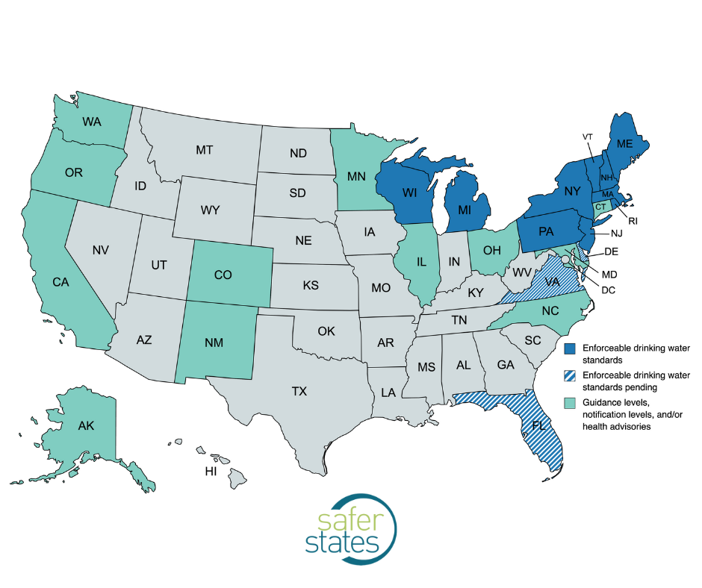
Does your drinking water contain PFAS?
Vermont's standard for the combination of five PFAS (PFOA, PFOS, PFHxS (perfluorohexane sulfonic acid), PFHpA (perfluoroheptanoic acid) and PFNA (perfluorononanoic acid)) is 20 ppt (parts per trillion). That means the sum of the five PFAS levels should not exceed 20 ppt in your drinking water.
Check out your public water source: www.ewg.org/tapwater/
https://anrweb.vt.gov/DEC/DWGWP/searchWS.aspx
What if you have PFAS in your water or blood?: https://www-pfas.pfas-exchange.org/report/graphtool/

Slide 9
Can I test my well for PFAS?
Cyclopure: www.cyclopure.com -- Tests are $79 total and include mailing to and from the lab. Cyclopure also sells water pitchers that take PFAS out of the water.
Certified testing labs for PFAS in drinking water in Vermont: Tests can cost anywhere from $350 to $500. https://dec.vermont.gov/sites/dec/files/documents/VDH%20Certified%20Laboratories%20PFAS_0.pdf

Slide 10
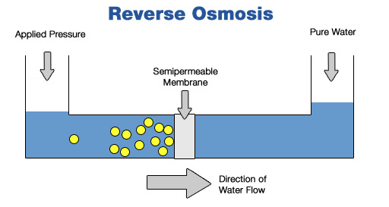
PFAS remediation systems for your home or business
Certain technologies have been found to remove PFAS from drinking water, especially Perfluorooctanoic acid (PFOA) and Perfluorooctanesulfonic acid (PFOS).
Those technologies include:
activated carbon adsorption,
ion exchange resins,
and high-pressure membranes, such as nanofiltration or reverse osmosis.
These technologies can be used in drinking water treatment facilities, in water systems in hospitals or individual buildings, or even in homes at the point-of-entry, where water enters the home, or the point-of-use, such as in a kitchen sink or a shower.
https://www.epa.gov/sciencematters/reducing-pfas-drinking-water-treatment-technologies
https://waterfilterguru.com/best-water-filter-for-pfas/ (Spring Well Whole House Water Filtration System, $1,000 to $1600)

Slide 11
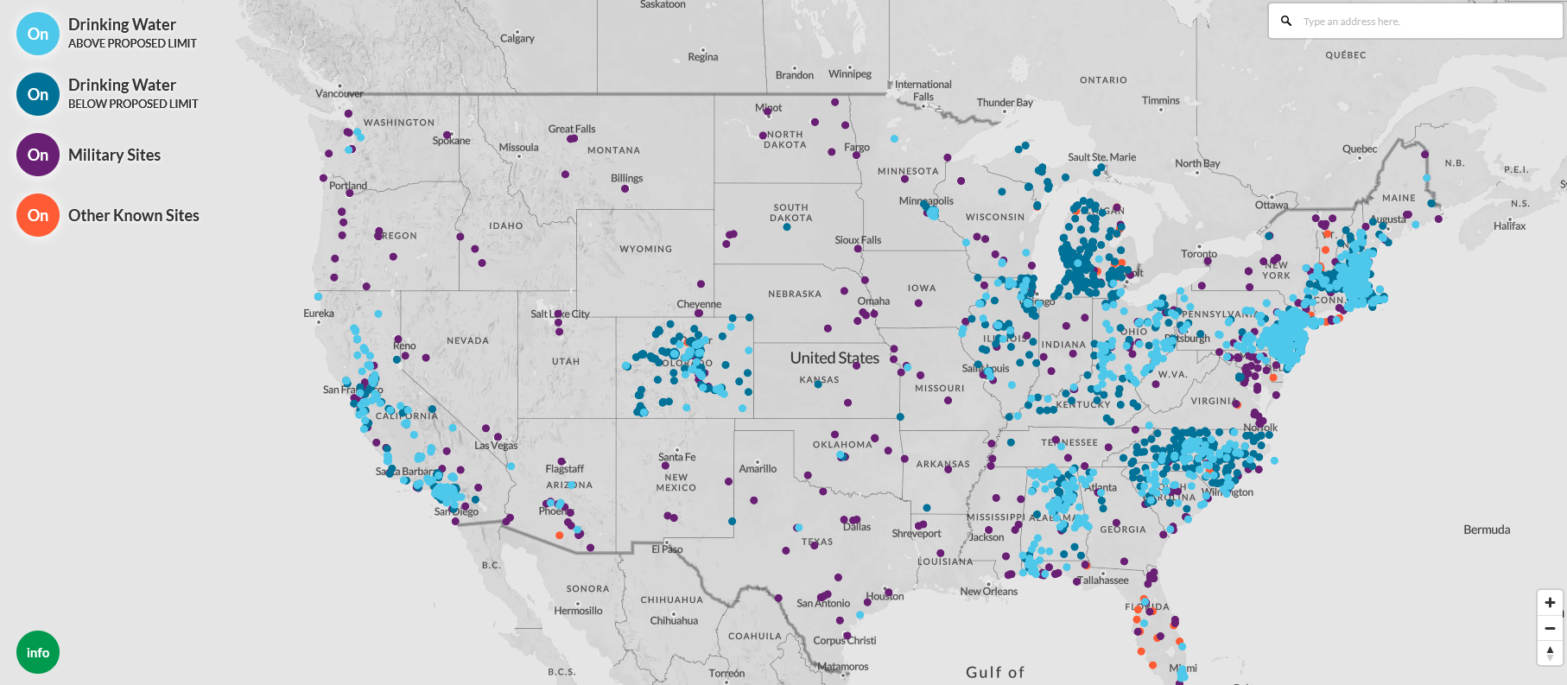
Water & military sites contaminated with PFAS?
https://www.ewg.org/interactive-maps/pfas_contamination/map/
Water quality data for VT: https://anrweb.vt.gov/DEC/DWGWP/searchWS.aspx

Slide 12
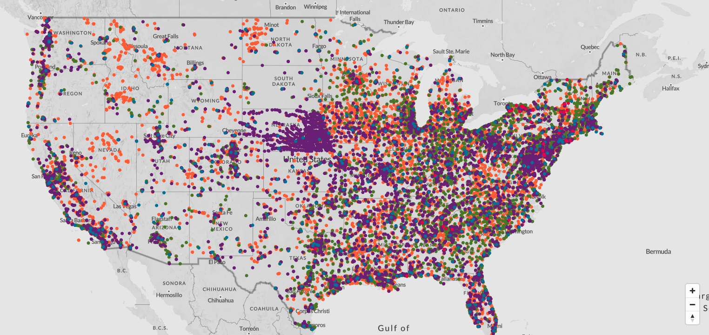
Industrial sites contaminated with PFAS?
https://www.ewg.org/interactive-maps/2021_suspected_industrial_discharges_of_pfas/map/

Slide 13
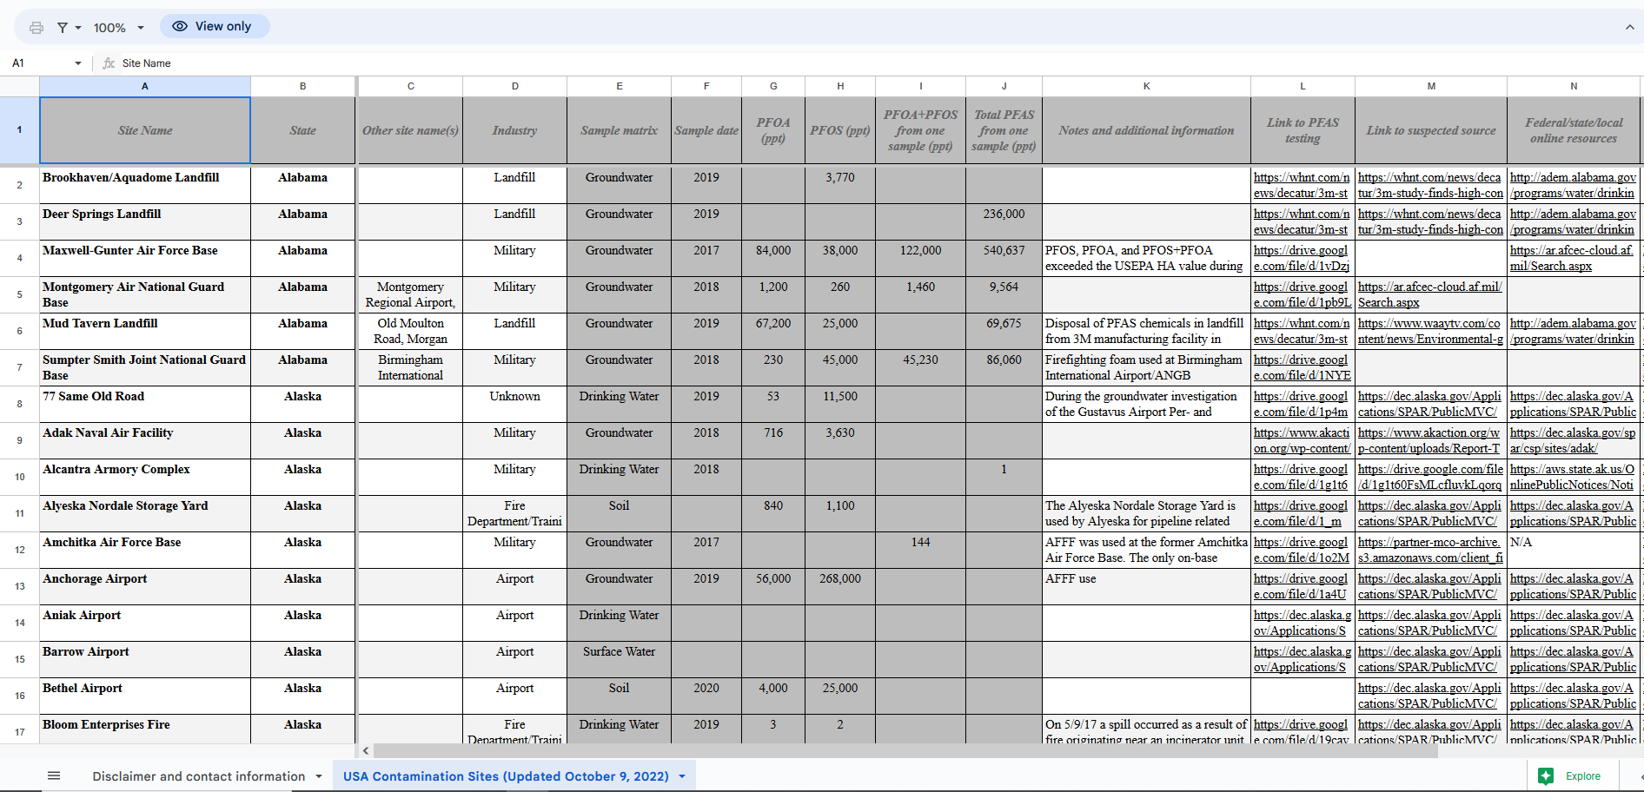
PFAS Contamination Site Tracker
https://docs.google.com/spreadsheets/d/1-LSXJbA_3M20n76y-FK0YLd1fml1uzJsoAkSWr2bz0A/edit#gid=0

Slide 14
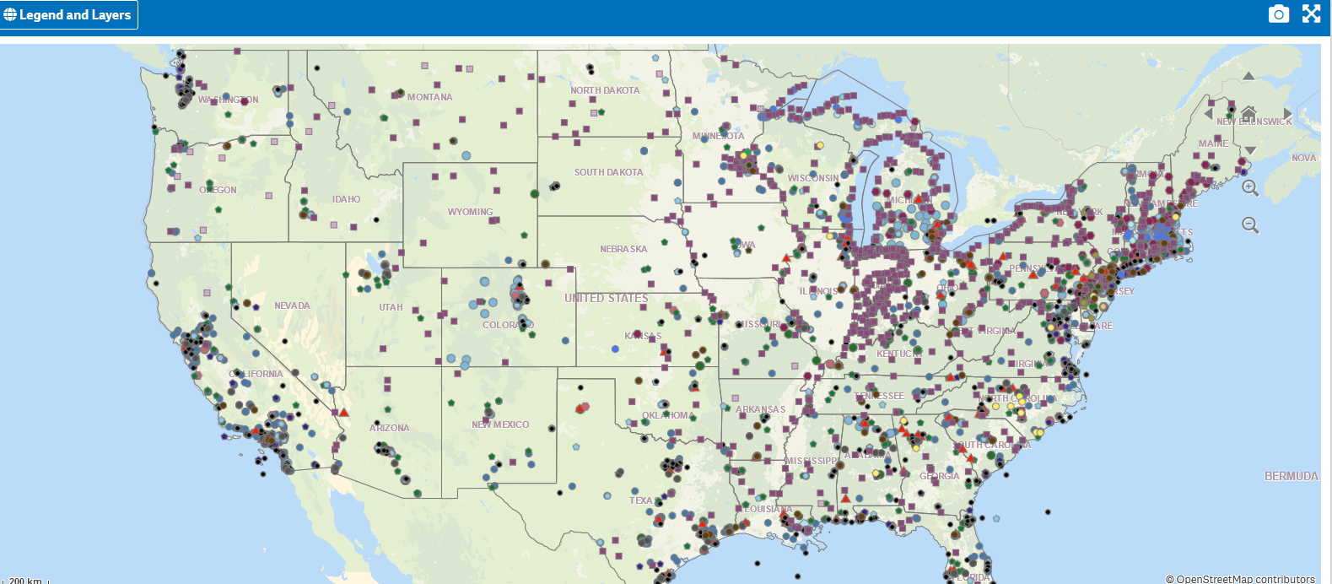
New EPA PFAS Analytic Tools
https://awsedap.epa.gov/public/extensions/PFAS_Tools/PFAS_Tools.html

Slide 15
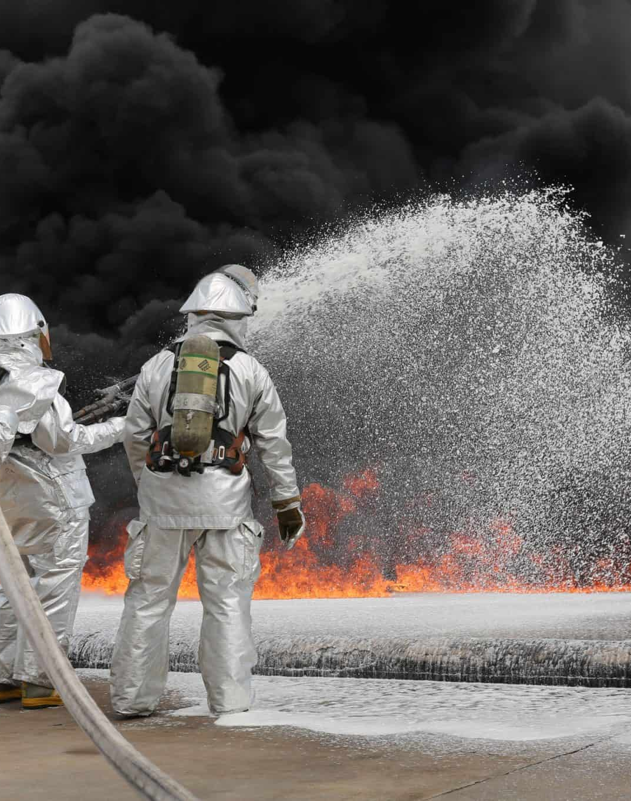
PFAS Contaminated Sites in Vermont
Keep in mind that the numbers are evolving as information is gathered. Inactive sites not included, but legacy PFAS are still likely at the site.
60 Public Drinking Water Systems
8 to 14 Superfund Sites
5 Military Sites
5 Airports
5 Fire Protection or Fire Training Sites (likely more)
173 Active Industry Sites
7+ Wastewater Treatment Plants (103)
36 Landfills
0 Reported Spills
Where are the highest known PFAS levels in Vermont; check out military sites, airports, and superfund sites.

Slide 16
What laws in my state protect me from PFAS?
Despite its small size, Vermont has been a leader in taking action to protect its citizens from exposure to toxic chemicals. In 2021, Vermont went above and beyond by adopting a nation-leading bill that restricts the sale of certain consumer products that contain toxic chemicals known as PFAS. Vermont was one of the first states in the nation to adopt drinking water standards for certain PFAS chemicals and to list these PFAS chemicals as hazardous waste.
www.saferstates.org
7 Current Policies being considered
22 Adopted Policies

Slide 17
How can I reduce my risk from PFAS?
Guidance on limiting PFAS exposure from the PFAS
Exchange: https://pfas-exchange.org/resources/how-to- reduce-your-exposure-to-pfas/
PFAS Free Products: https://pfascentral.org/pfas-free-products/
EWG: https://www.ewg.org/withoutintentionallyaddedpfaspfc
Silent Spring smartphone app: https://silentspring.org/detox-me-app-tips-healthier-living
Cleaning Supplies: https://www.ewg.org/guides/cleaners/content/methodology/
Home Guides: https://www.ewg.org/healthyhomeguide/
Office Depot--Greener Office: https://www.officedepot.com/cm/marketing/greener-office
Building Supplies: https://www.greenbuildingsupply.com/
Staples: Eco-id program
Amazon: Shop PFAS free
Green Screen: Check the list of GreenScreen Certified products: https://www.greenscreenchemicals.org/certified/products
This Photo by Unknown Author is licensed under CC BY-SA

Slide 18
What actions can I take on PFAS?
Educate yourself about PFAS
Set up a Goggle Alert for PFAS
Don’t use products that have PFAS
Rebel against consumerism
Write to manufacturers who use PFAS in their products
Ask your school district and city to stop buying products with PFAS.
Advocate for legislation to ban PFAS at the state level.
Advocate for legislation to ban PFAS at the national level.
This Photo by Unknown Author is licensed under CC BY-ND

Slide 19
EPA Regional PFAS Community Engagement Sessions
The EPA has already held Regional Engagement Sessions. You can request information at: https://pfascommunityengagement.org/
You can also learn about the EPA’s Strategic Roadmap for PFAS at:
https://www.epa.gov/pfas/pfas-strategic-roadmap-epas-commitments-action-2021-2024

Slide 20
Resources You Can Use
www.militarypoisons.org
www.ewg.org
https://pfasproject.com
www.saferstates.org
https://pfascentral.org
A project of the Women’s International League for Peace and Freedom Earth Democracy Committee. For more information, contact Marguerite Adelman, WILPF Burlington Branch, at pfasinfo@wilpfus.org

